Slide 1
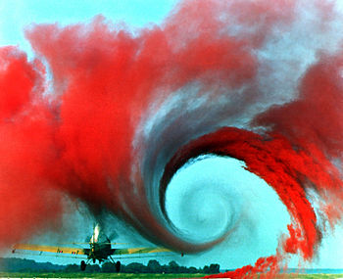
Basic Aerodynamics
Thursday, February 7, 2019
Notes:
Welcome to the sample lesson plan! Feel free to explore this lesson plan, and reach out by text to (360) 704-0940 if you have any questions.
Notes are included for most lesson plans with normal font indicating copied content from the slide, and bold content indicating how I elaborate on each point.
All lesson plans are fully editable, but be sure to click “Enable editing” in the yellow strip up near the top.
Enjoy!

Slide 2
Basic Aerodynamics
Objective: To instruct the student, through lecture, the fundamentals of how aircraft fly.
Motivation: Knowing how aircraft achieve flight is common knowledge for any pilot, and must be thoroughly understood.
Overview: This lesson will explain:
The four forces of flight
Airfoils
Bernoulli's principle
Newton’s 3rd law
Blade stall
The three axes
NEXT
Notes:
Objective: To instruct the student, through lecture, the fundamentals of how aircraft fly. Not designed to make you an aerospace engineer. Which will make you a better pilot. We can teach a monkey how to push sticks around, but learning the process behind flight will make you a much more competent pilot.
Motivation: Knowing how aircraft achieve flight is common knowledge for any pilot, and must be thoroughly understood.
Overview: This lesson will explain:
The four forces of flight
Airfoils
Bernoulli's principle
Newton’s 3rd law
Blade stall
The three axes

Slide 3
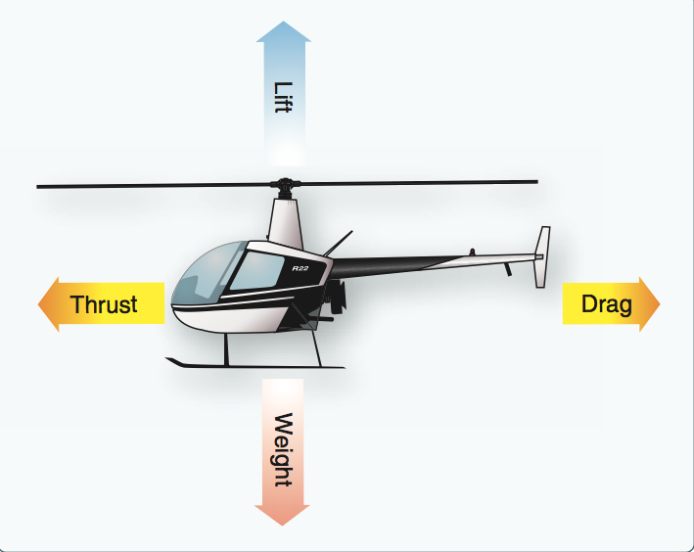
The Four Forces of Flight
Weight: Downward force of gravity on an object.
Lift: Upward force that opposes weight. (Created by an airfoil)
Thrust: Force that moves an object through the air.
Drag: Resistance of an object through the air.
Thrust
NEXT
Notes:
Any training in aviation should begin with aerodynamics. And any training on aerodynamics should begin with the four forces of flight.
Do you remember them from your reading?
Lets not take them for granted, lets explain each of them.
Weight: Downward force of gravity on an object. This is the gravitational pull of the earth. It is a pull from below, not a push from above.
One thing I want you to notice is that each of these forces has an opposite. Weight opposes lift, drag opposes thrust.
Lift: Upward force that opposes weight. (Created by an airfoil) There are different ways to create lift. Rockets balloons, lifting weights. We are going to talk about creating lift with an airfoil.
We will talk most about this. Because it is the method we use.
Thrust: Force that moves an object through the air. I thought I understood thrust. I was dead wrong. I thought that thrust was the direction of the fire on a rocket, all the exiting stuff. DRAW PICTURE OF ROCKET. Thrust is always in the direction of movement.
Drag: Resistance of an object through the air. Essentially the friction of your aircraft through the air.

Slide 4
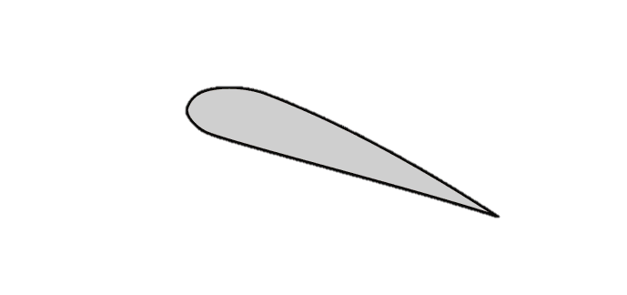
Airfoils
An airfoil is any surface designed to create lift as it moves through the air. (e.g. Wing, rotor blade)
Camber
Leading Edge
Trailing Edge
Chord Line
Relative Wind: Always parallel and opposite the direction you are moving.
NEXT
Notes:
An airfoil is any surface designed to create lift as it moves through the air. (e.g. Wing, rotor blade) This sentence is carefully constructed and worded. It is a surface that is designed, so it doesn't’t happen by accident. To create lift as it moves through the air, or air moving over it. If an airfoil is moving forward through the air, it will create lift, or if the airfoil is stationary, and wind is blown over it, it will create lift.
This is why we tie airplanes down.
This is our typical airfoil. Cross section view.
Which side is the front end, which is the back?
The pilot should know the anatomy of a typical airfoil.
We don’t call this thing the big blunt end, we call it the leading edge.
Then what is this end? Trailing edge.
We have a little more curvature on the top than the bottom, this is called he camber.
We also have an imaginary line that goes through our airfoil from the leading edge, to the trailing edge. We call this the chord line. We never are flying around and think “Oh I wonder what my chord line is up to” It is an academic term we use in the class. And we use it because in a minute we are going to talk about changing the angle of this blade, and we need something to measure that angle with. How many degrees of angle? 10? 15? 45? That’s all its used for.
Any pilot should understand these four basic terms.
This doesn't show how it works, but it shows you basic anatomy. And before I tell you how it works, I have to explain one more term, and that term is relative wind.
We don’t even need to be talking about airfoils when talking about relative wind. Relative wind is best explained with an example. If Im just sitting on a motorcycle, stationary, and I have a 10 mph wind at my back, I have 10 mph of wind hitting me in the back. If I start that motorcycle and drive 10 mph on my speedometer, now the wind is calm. Then if I speed up to 100 mph on my speedometer, I really have 90 mph hitting me from the front.
Or if I take a bowling ball, and drop it from the empire state building, which way is the relative wind?
And here is another way of thinking about it. If something is moving this way, the relative wind is that way. Use fingers.
Now having said all of this, lets see how all of this fits together, this is where the real meat comes in. NEXT SLIDE CLEAR TEXT

Slide 5
Airfoils
Relative Wind
NEXT
Notes:
Now having said all of this, lets see how all of this fits together, and see how it creates lift, this is where the real meat comes in.
So if my airfoil is moving this way, which way is the relative wind?
Here comes the relative wind.
And when the relative wind comes, it is not going to tunnel through this airfoil, it s going to split it is going to go over and under it.
Notice something right off the bat. When the air goes around the airfoil, notice it does not hit the leading edge and get deflected, and go all over the place and become turbulent, if this happened, this wouldn’t work. These airfoils are carefully constructed and designed so that when air goes around it, it stays with the airfoil and hugs the surface as it goes over, stays along the surface, and is reintroduced smoothly.
The air over the surface of tha airfoil is called the boundary layer. And in this case, we would say that the boundary layer is laminar. It has a laminar flow. And we want this, it is important. They are specially designed so the air does this.
Lets take a step back for a second, ive been talking a lot about air flow, airfoil, air this, air that. But what is air? This room is full of air, but you cant see it. Its invisible. But when I move my hand, I can feel there is substance. Air is made of gasses, oxygen, nitrogen, carbon dioxide, helium, ect. There is substance to air. It is made up of trillions and trillions of molecules. These molecules are going to have a reaction when they hit this airfoil. Even though we cant see it.
Lets highlight the journey of two molecules as they hit this airfoil. They are all going to follow suit, this is for demonstration purposes that I am picking two.
Lets say these are two molecules that both strike the leading edge at the same moment. Lets say this one is just high enough that it will go over, and this one is just low enough that it will go underneath. Which one of these has a longer distance to travel to get to the back? Larger camber.
Having said that, take a guess which of these two molecules do you think will get to the back first?
Not exactly. They get there in the same amount of time. Crazy right? How does that work? Why wouldn't’t it take the top longer to get to the trailing edge? I think you are lying to me Spencer.
In order to explain all of this, we have to hit the pause button for a minute. And in order to explain this, Im going to give you a quick history lesson.

Slide 6
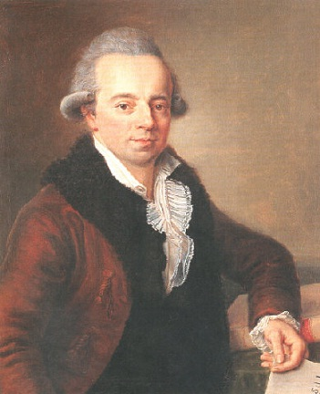
Daniel Bernoulli
Considered the Father of aviation
Lived in 1800’s
PUMP
Notes:
He experimented with water and pumps. Essentially fluid dynamics. He was trying to invent a better water pump.
He is known as the father of aviation. Even though there was no aviation. He died before he knew he was the father of aviation. The experiments he did was later used to invent aircraft.
Lets look at an experiment of his that led to an important discovery.
This water pump is going to suck up water, and spit it out over here.
Lets say this pump of Bernoulli’s is designed to pump 20 gallons per minute. BTW I have no idea if it pumped 20 gallons per minute. Its an arbitrary number used for the example.
He is a scientist, and he is going to double check these things. He turns the pump on for one minute, and then measures the volume of water that was pumped. Sure enough, 20 gallons in 1 minute, like it was designed.
Then he thinks, “How can I effect flow rates” can I modify these pumps so they pump more, or less? He modified this pipe here. NEXT

Slide 7
Daniel Bernoulli
When your force a fluid through a venturi
The speed will increase
The pressure will drop
PUMP
Venturi
NEXT
Notes:
So Bernoulli modified this pipe right here, and put a dent in it. He is trying to restrict the flow of the water. Thinking, “Surely this will slow the fuel rate down” so he flicks the switch, the pump turns on and he times it for one minute. And woah! There was 20 gallons again. He thought there would be less, if he restricted the flow. No matter what he did short of closing it, it was always 20 gallons per minute.
So he put some meters in there to measure the speed and pressure of the water. And he discovered two really imprtant things.
He discovered that when you force a fluid through a restriction, or Venturi. CUE VENTURI.
When your force a fluid through a venturi
The speed will increase
The pressure will drop
Another example of this would be a garden hose. When you turn it on, that water might be coming out and going four of five inches but when you put your thumb over the nozzle, you can get your friend 30 feet away. You are creating a venturi. The liquid is accelerating through the venturi.
Now you are probably thinking, “What the heck does this have to do with airfoils?” Well lets look at this shape here closer. What does this remind us of? Our airfoil.
When I started this history lesson I kept saying water, water this, water that. But towards the end of the explanation, I started saying fluid.
Lets talk about what the word fluid means. Water is a fluid. So it air. A fluid is anything that flows, and that keeps the chape of its container. We know that air flows, and we know that air keeps the shape of its container. The air in this room is room shaped. Air qualifie as a fuild also.
When your force a fluid through a venturi the speed increases and the pressure drops. A fluid, not just water. So this would work if it was water, dr pepper, beer, air.
When your force air through a venturi, you speed it up, and the pressure drops.
Lets take this idea, and go back and apply this.

Slide 8
Airfoils
L
H
NEXT
Notes:
Now lets go back to the airfoil, and apply what we just learned.
All this air is rushing towards this airfoil.
Now look what happens, this air on top, is getting squeezed, its speeding up, and its pressure is dropping. So the top of our airfoil is creating a venturi out of thin air. Air is going to be forced to squeeze as it goes over the top.
That is how the molecules get there in the same amount of time.
This creates an area of low pressure above the airfoil, and a comparatively higher pressure below. A high pressure will ALWAYS seek out a low pressure system. The universe does not like to be out of balance. The airfoil is between the two, so it gets pushed upward by that high pressure, that is seeking out that low pressure.
Now we have all stuck our hand out the window, and thought to ourselves, “Oh this is how airplanes fly” not really, a little bit, we will talk about that later. About 10% is that slicing action. 90% is the venturi effect, or bernoulli’s principle.
At this point, does that make sense? Important, must have it to move on.

Slide 9
Airfoils
Increase the speed of the airfoil
L
L
Relative Wind
Relative Wind
H
H
NEXT
Notes:
Now what if I want to increase my lift? Lets say im flying along at 1000 feet, and I want to go up to 2000 feet, how can I cause my airfoil to create even more lift.
We can do two things to increase the lift of an airfoil.
The first is to increase the speed of the airfoil.
As the speed of the airfoil increases, the relative wind opposite the airfoil increases, and the pressure differential increases.
A common example of this is an airplane taking off of a runway.
They go wailing down the runway. As their wailing down that runway, they are gaining speed, and gaining lift.

Slide 10
Airfoils
Notes:
I said that there were two ways we could increase the amount of ift that an airfoil produces. So what’s the second way?
What if we could somehow increase the size of our upper camber? What if I could put a tire pump, and inflate my upper camber, and make it even bigger? CUE CAMBER
Well that would cause the air on top, to have to travel an even grater distance, in the same time, and that air would have to travel even faster. The faster that air is moving, the lower the pressure on the top of the airfoil, and the more lift you get.
But I doubt you would be able to find any inflatable wings out there, its not a practical design.
But they don’t have to, because there is a way we can mimick this, and still get the same results. And what we do, is just change the angle of our airfoil.

Slide 11
Airfoils
Relative Wind
NEXT
Notes:
We tilt our airfoil up like this, and it mimics having a larger camber.
So our relative wind is still from the same angle, just because it is pointed on one direction, doesent mean it is going in that direction, its still moving in the same direction, therefore, the relative wind is coming from the same direction.
Now when we bring in the air, it is going to go up and over a larger, or seemingly larger camber. This forced the air to have to go over a larger obstacle.
By changing the angle of the airfoil, we can get more lift.
Now having said this, we have a couple vocabulary terms we need to talk about.

Slide 12
Plane of Rotation
Plane of Rotation: The path the rotor blade follows.
Notes:
First we are going to talk about plane of rotation.
Do you remember reading in your book about that?
Plane of Rotation: The path the rotor blade follows.
You can actually see the plane of rotation with helicopters, its that imaginary disk you see.
Some people call it the tip path plane.

Slide 13
Plane of Rotation
Plane of Rotation: The path the rotor blade follows.
NEXT
Notes:
First we are going to talk about plane of rotation.
Do you remember reading in your book about that?
Plane of Rotation: The path the rotor blade follows.
You can actually see the plane of rotation with helicopters, its that imaginary disk you see.
Some people call it the tip path plane.
Now I am going to talk about two terms in your reading that might have given you a little grief. Im going to talk about pitch angle, and angle of attack.

Slide 14
Pitch Angle
Pitch Angle: Angle between the chord line of rotor blade and plane of rotation.
NEXT
Notes:
These two terms are related, but they are not the same thing.
Lets take them one at a time.
Here is our airfoil, and our airfoil is moving along our plane of rotation.
Here is that imaginery chord line we talked about.
Pitch is just the angle between the plane of rotation.
If you were on the plane of rotation, you would be at flat pitch.
Then what is angle of attack?

Slide 15
Angle of attack
Angle of Attack: Angle between chord line and relative wind.
Relative Wind
Relative Wind
NEXT
Notes:
They start out almost identical in their definition.
It starts out the angle between the chord line and blank.
Angle of Attack: Angle between chord line and relative wind.
Its slightly different.
Lets say im moving perfectly straight and level, my blades are spinning along that plane of rotation. And I am moving perfectly level. Which means the relative wind is coming this way.
So in this case, the pitch angle and the angle of attack are identical.
BUT, what if I was descending? When we descend, in a helicopter, we don’t usually go into a dive. We stay level, and just go down like this.
So if I stay level, my plane of rotation is still flat and equal with the ground. But the helicopter is now going that way, which way is the relative wind? Opposite. CUE SECOND REALTIVE WIND
Now my angle of attack is bigger, because the relative wind is coming in a different direction.
The bigger bite those blades take as they come around, the more lift they produce because the air is going to have to come up and over a much larger.
So if I change the pitch, it will change the angle of attack, they are related, but they are not the same.

Slide 16
Angle of attack
Notes:
SO to gain extra lift, we increase the angle of attack. Simple right? NEXT

Slide 17
Angle of attack
Notes:
But, can we keep doing this forever? No, the problem is when you increase your angle of attack, you are increasing the drag. Because the blades have to push through the air.
So as you get more lift, you are also getting more drag.
Lets look at this animation of the air moving over and under the airfoil, the lines represent that nice laminar flow.
We’ve increased the angle of attack already, so far so good. But if we increase it even more, something starts to happen.

Slide 18
Angle of attack
Notes:
Look at the trailing edge, when you increase the angle of attack a little too much that laminar flow begins to separate, starting at the trailing edge. We don’t want this, we like the smooth, laminar flow.

Slide 19
Angle of attack
Notes:
If we increase it even more, we see that turbulent flow starts to spread along the airfoil, reducing the amount of lift it produces even more.

Slide 20
Angle of attack
Critical Angle of Attack
Blade Stall: Too much angle of attack, air flow separates, all lift is lost.
NEXT
Notes:
If we keep increasing that angle of attack, there is a point where the laminar flow completely separates from the airfoil, we call this the critical angle of attack. At this point it is not producing lift. Now you fall out of the sky.
We call this a stall. In aviation a stall means that an airfoil stops producing lift.
It does not mean that your engine quit. That’s a term we use in the civilian world all the time. “Oh my car stalled” We don’t use stall like that. We only use it when talking about airfoils. We say our engine failed. Fyi.
We need to be using terms correctly when in the aviation environment.
Yikes, we want nothing to do with that. Don’t do that.
How many degrees of angle of attack will cause this to happen? That should be simple, how many degrees is that so I don’t do that? I cant tell you many many degrees it is. Oh no. How am I supposed to know whan I hit it? It changes according to temperature, air density, the altitude, the speed of the airfoil. There are so many vatialbles, its impoossible to have one set critical angle of attack.
This is not meant to be your training on this particular gauge yet, but im just going to give you a quick taset of whats coming up in later classes.
This is called our manifold pressure gauge. You see the red line. When you raise the collective, It increases the angle of attack on the blades, which makes the engine work harder. That causes that needle to go up, and we expect that. But if you get to a point where it is working so hard, that it hit the red line, you are getting close to that criticcal angle of attack.
You don’t have to know how many degrees it is, and you couldn’t look outside and see. But if you watch this thing, you know as long as you don’t hit that red line, you are good.
BLACK SCREEN “B”
Unfortunatly, there are 2 different ways we can stall an airfoil.
Think back, what were the two things that could increase the lift of an airfoil?
Increase the speed, increase angle of attack. Those same two things that can cause stalls.
If we increase AOA too much we can stall the airfoil.
If I go faster and faster, that creates more lift.
If I go slower, logically that would create what? Less lift.
It is possible to go so slow, that you are not supporting the weight of the aircraft.
Its not that you are not creating lift, its that you are not making enough lift.
USE DESK
Im applying lift to this table, but not enough, the desk is not impressed by mu lifting. I just doubled it. Still not moving.
Until eentually, I produce enough lift to lift the table. But I had to up the ante a bit
Its possible for airfoils to create lift, but not enough lift.
I garuntee you if you put a 747 wing in a wind tunnel, and blew 5 mph of wind over it and put some meters on it, its creating lift, but not very much.
This is why what airplanes have what is called a stall speed. It’s the speed where they will fall out of the sky. Its different for each airplane.
For helicopters. Can we stall our airfoils> Yes. If I raise that colelctive too much, we can exceed that critical angle of attack, and boom, blades are stalled.
But I see helicopters come to a hover, why are they not stalling their airfoils. Because their blades are still spinning. Just because this thing is at zero, doesent mean this thing is. This thing is still going 400 MPH. That’s what makes us different than airplanes.
Now that doesent mean we cant stall our airfoils de to speed. If we start to lose RPM, the blades slow down, and we fall out of the sky. We are still subject to the same thing as airplanes, just in a different way.

Slide 21
Newton’s Third Law
Newton’s Third Law: “For every action, there is an equal and opposite reaction.”
Lift
Relative Wind
NEXT
Notes:
We said that about 90% of our lift comes from the bernoulli effect we just described. Well, by my math that leaves about 10% unaccounted for.
Where does the other 10% come from? It comes from Newtons Third Law.
We have all heard of issac Newton, do you know what his third law was?
Newton’s Third Law: “For every action, there is an equal and opposite reaction.”
The second law is the relationship between an objects mass, and acceleration, and the first is an object in motion tends to stay in motion unless acted upon.
The relative wind is coming from this direction, and some of the air is deflected off the bottom of this airfoil.
This one is much easier to wrap our heads around.
Air comes in and ricochets off the bottom. The equal and opposite reaction is an upward force.
That’s the hand out the window thing.

Slide 22
Types of Airfoils
Symmetrical Airfoils: Have the same camber on both the upper and lower surfaces. Symmetrical airfoils tend to be very stable and generally have better lifting capability.
Asymmetrical Airfoils: Do not have the same camber on the upper and lower surfaces. These airfoils are generally less stable than symmetrical airfoils but are better suited for higher speeds.
NEXT
Notes:
Up until now, I have been using a very specific type of airfoil for all of my examples.
It had more camber on the top, and less camber underneath, and I use this for ease of instruction, but we kind of need to back up now.
I need to tell you there is two different types of airfoils.
There are symmetrical airfoils, and asymmetrical airfoils.
So we know that symmetrical means its equal on either side, right?
Lets look at what the textbook says.
Symmetrical Airfoils: Have the same camber on both the upper and lower surfaces. Symmetrical airfoils tend to be very stable and generally have better lifting capability.
Asymmetrical Airfoils: Do not have the same camber on the upper and lower surfaces. These airfoils are generally less stable than symmetrical airfoils but are better suited for higher speeds.
What? That’s weird. Everything you just taught me says that a symertrical airfoil cant fly.
Here is a symetrical airfoil.

Slide 23
Symmetrical Airfoil
Notes:
Up until now, I have been using a very specific type of airfoil for all of my examples.
It had more camber on the top, and less camber underneath, and I use this for ease of instruction, but we kind of need to back up now.
I need to tell you there is two different types of airfoils.
There are symmetrical airfoils, and asymmetrical airfoils.
So we know that symetrical means its equal on either side, right?
Lets look at what the textbook says.
Symmetrical Airfoils: Have the same camber on both the upper and lower surfaces. Symmetrical airfoils tend to be very stable and generally have better lifting capability.
Asymmetrical Airfoils: Do not have the same camber on the upper and lower surfaces. These airfoils are generally less stable than symmetrical airfoils but are better suited for higher speeds.
What? That’s weird. Everything you just taught me says that a symertrical airfoil cant fly.
Here is a symetrical airfoil.
Well that s weird, the air is speeding up, but its speeding up on both sides! That’s weird.
Airplane wings are always asymmetrical airfoils, helicopter main rotors are usually symmetrical.
Helicopters have to have a neutral point.
We don’t speed them up and slow them down to go up and down.
We can be on the ground and not produce any lift
If we had asymmetrical airfoils, we would take off when we started the engine.
Speed it up slow it down, zero pitch,
So we change its angle of attack. Remember what we are doing when we change the angle of attack, we are exaggerating one of the cambers. We arent really changing the camber, we are exaggerating it. The relative wind recognizes it as a larger obstacle, even though we havent changed the object. NEXT SLIDE

Slide 24
Symmetrical Airfoil
NEXT
Notes:
So see what happens when we change the angle of attack.
So a symetrical airfoil at zero pitch produces no lift, which is perfectly suited for helicopter main rotor.
I could think of a way we could have a helicopter main rotor, with an asymmetrical airfoil.
Negative pitch.
Notice I said main rotor has symetrical.
Tail rotor has asymmetrical. Because when we turn that engine on, we want out tail rotor to be producing anti torque immediately. We may not be producing lift, but we are producing torque.
Im done talking about lift. NEXT SLIDE

Slide 25
Three Types of Drag
Three Types of Drag:
Profile Drag: Caused by friction of the rotor blades (e.g. Any surface roughness and not angle of attack)
Induced Drag: Caused by rotor blades and increased angle of attack.
Parasite Drag: Caused by anything that does not create lift (e.g. skids, cabin, rotor mast etc.)
NEXT
Notes:
Although I do want to follow up and spend the last couple of minutes talking about drag.
There are three primary categories of drag out there.
Three Types of Drag:
Profile Drag: Caused by friction of the rotor blades (e.g. Any surface roughness and not angle of attack) If I have an airfoil made of sand paper, it wont cut through the air nearly as well as a smooth airfoil.
Induced Drag: Caused by rotor blades and increased angle of attack.
Parasite Drag: Caused by anything that does not create lift (e.g. skids, cabin, rotor mast etc.)
----- Meeting Notes (11/28/12 14:35) -----
pilot induced drag

Slide 26
The Three Axis
Longitudinal: (Roll)
Lateral: (Pitch)
Vertical: (Yaw)
NEXT
Notes:
Make a note to mention that you always refer to the aircraft at the front.

Slide 27
Conclusion
Conclusion: This lesson explained:
The four forces of flight
Airfoils
Bernoulli's principle
Newton’s 3rd law
Blade stall
The three axes
NEXT

