Slide 1
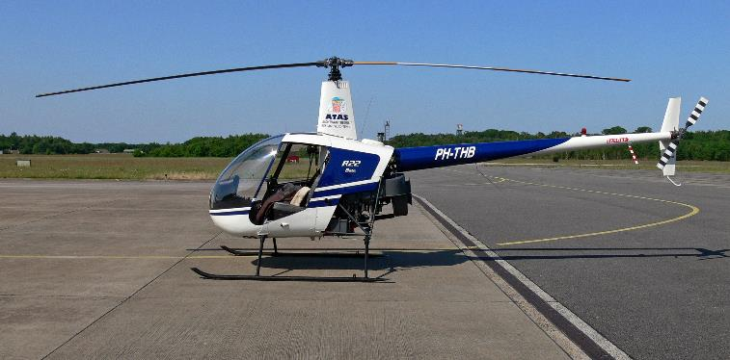
180º Autorotations
Tuesday, February 12, 2019

Slide 2
180º Autorotations
Purpose: To simulate landing helicopter by turning 180 degrees during engine failure (i.e. into the wind).
Prerequisites: Straight-in autorotations
Steps:
From straight and level, aligned into the wind, 800-1000 feet, pre-landing checks, 70-75 knots.
Establish level attitude on the horizon.
Lower collective full down, close throttle, maintain heading with pedals (right pedal), collective back up a notch.
Establish 65 –knot attitude.
Start turn, up another notch on collective.
Coming out of turn, collective down a notch.
Check RPM, check airspeed
At 200 feet begin slight aft cyclic to decelerate, lower collective to build rotor RPM’s
Upon deceleration, forward cyclic to level aircraft, raise collective and hover forward.
NEXT

Slide 3
Common Errors
In the turn, nose pitches down.
WHY: Looking at ground and not horizon.
CURE: Show them the horizon (“keep eyes on horizon”)
High rate of descent through turn.
WHY: Out of Trim
CURE: Look at horizon (if you look at horizon, you will see the trim strings!!)
NEXT

Slide 4
Completion Standards
Private Commercial
Landing Spot: N/A + or – 50 Feet
RPM: N/A Green
Airspeed: N/A + or – 5 Knots
NEXT

